Slide 1
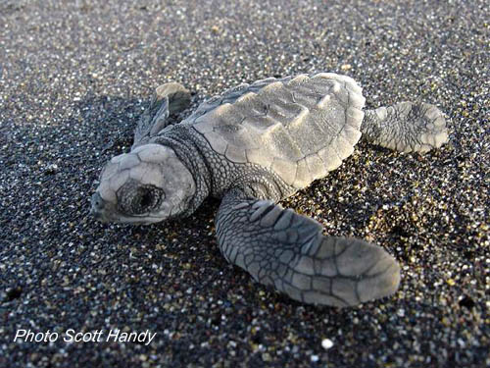
Secret Bonus Example: Sea Turtles
Existed at least since the Jurassic period (~200 to 140 million years ago).
Air breathing.
Spends life in ocean.
Adults return to natal
beach to lay eggs.

Slide 2
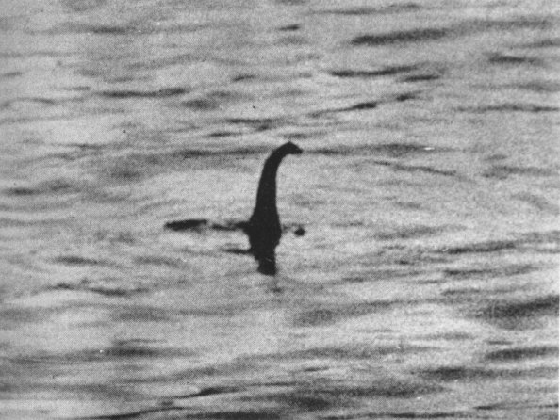
Another Jurassic Aquatic Reptile?

Slide 3
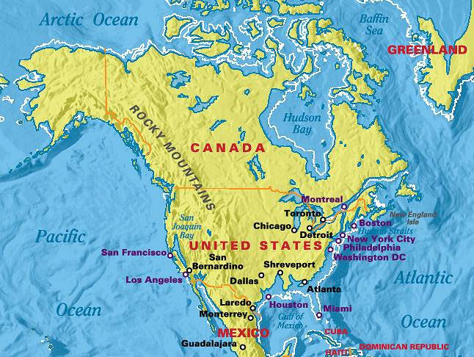
Sea Turtles in Atlanta?
www.maps-eureka.com/world-in-2150-namerica.html

Slide 4
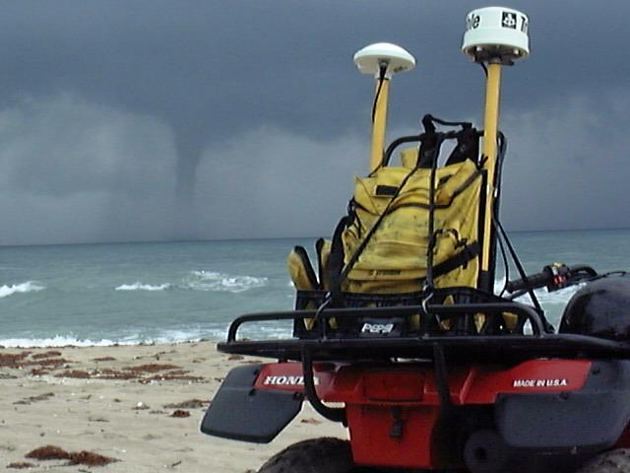
A day on the beach…

Slide 5
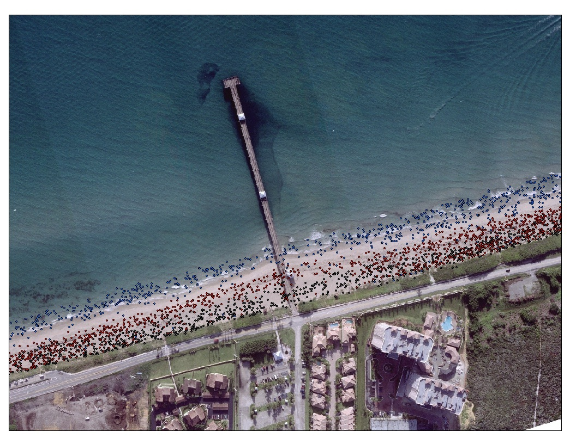
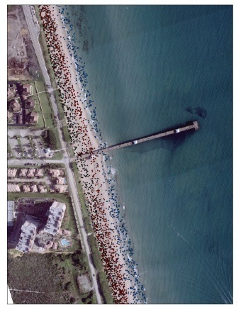
A: Juno Beach Pier

Slide 6
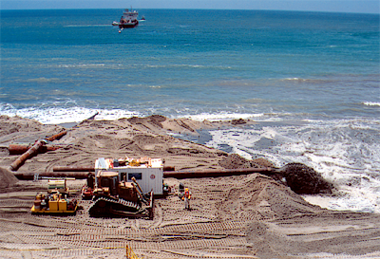
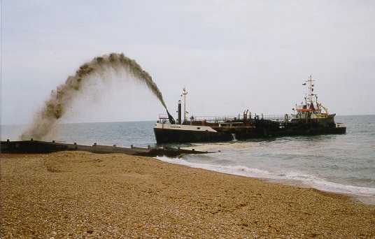
Beach nourishment
http://coastalchange.ucsd.edu/images/nourishment3.png
http://www.havant.gov.uk/images/boat1.jpg

Slide 7
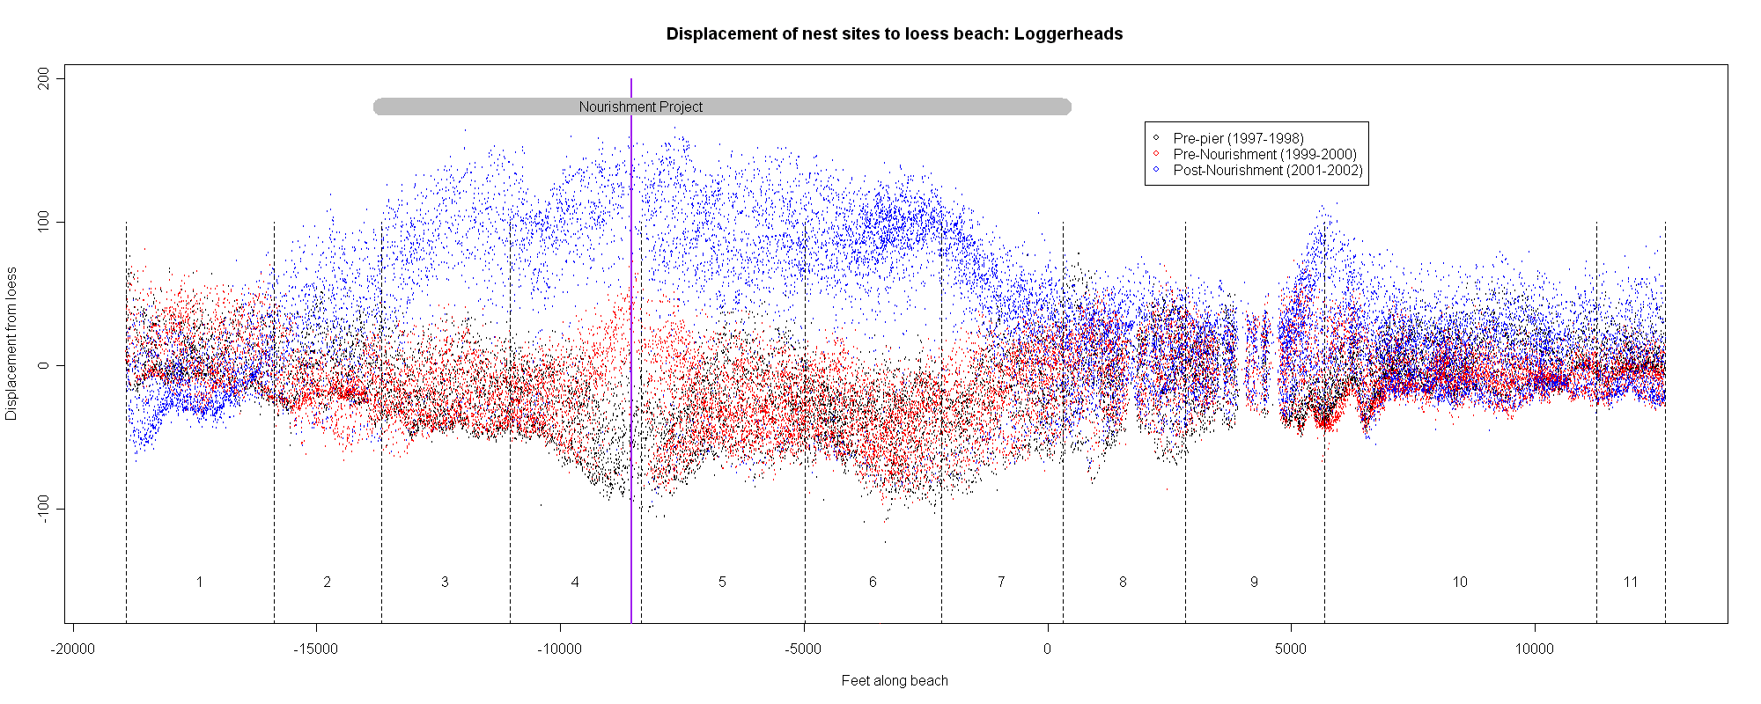
Points on the beach
1997-1998 (black), pier, 1999-2000 (red), nourishment, 2001-2002 (blue)
B
C
A

Slide 8
A: Juno Beach Pier

Slide 9
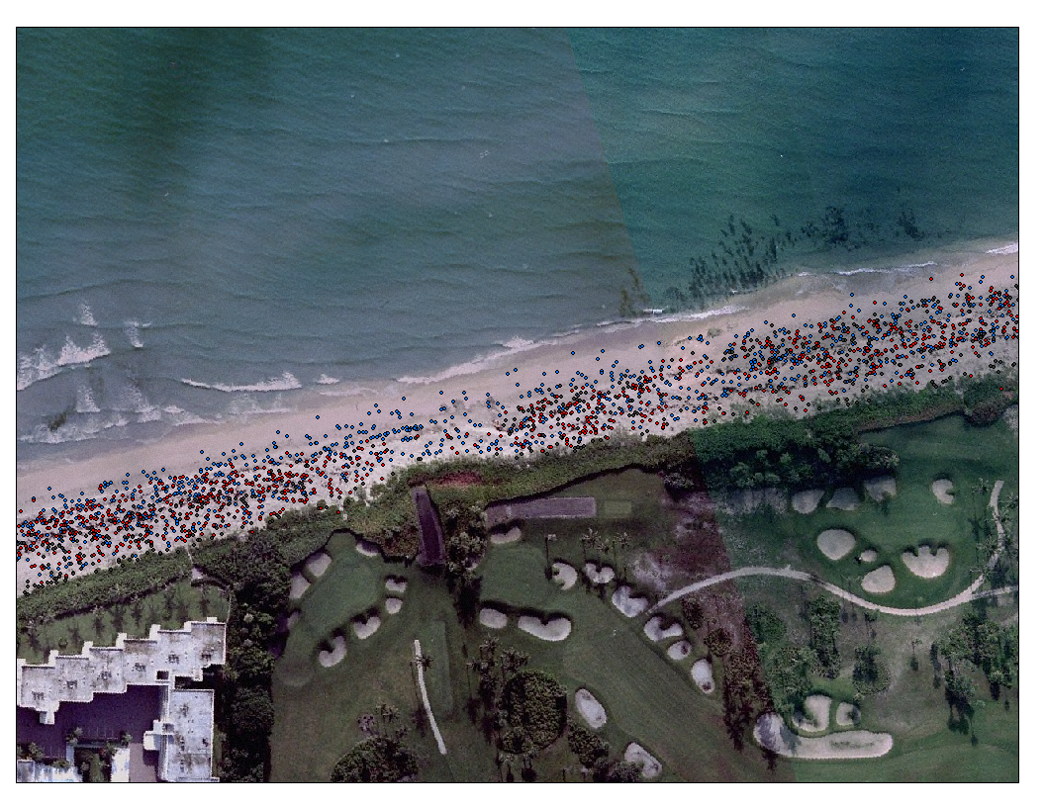
B: Gap in pre-pier, pre-nourishment

Slide 10
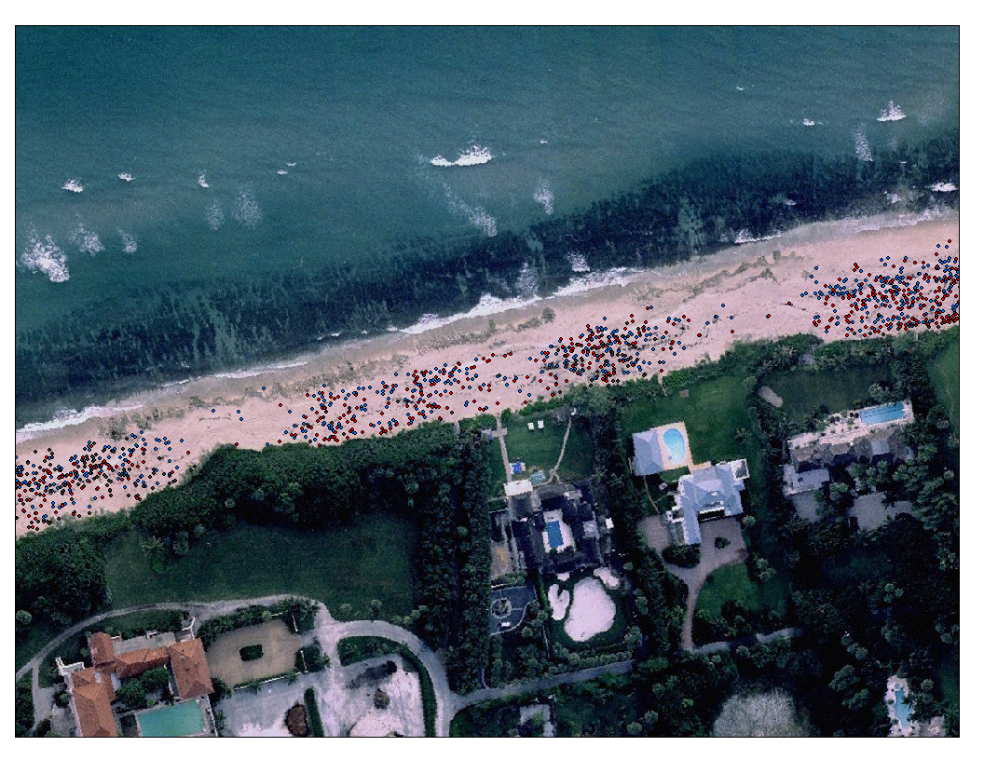
C: Gaps across all three periods

Slide 11
How do I measure where there are changes?
Distribution along beach is important BUT
It isn’t a standard distribution.
I don’t care what it is, I just want to estimate it.
Smooth histogram (“kernel estimate”)

Slide 13
Does that help?
What’s my question: Did the pattern (distribution) of nesting change after nourishment?
Calculate:
Distribution pre-nourishment (1999-2000)
Distribution post-nourishment (2001-2002)
Compare curves (take ratio of post to pre).
“Peaks” mean more emergences post, “valleys” mean more emergences pre.

Slide 14
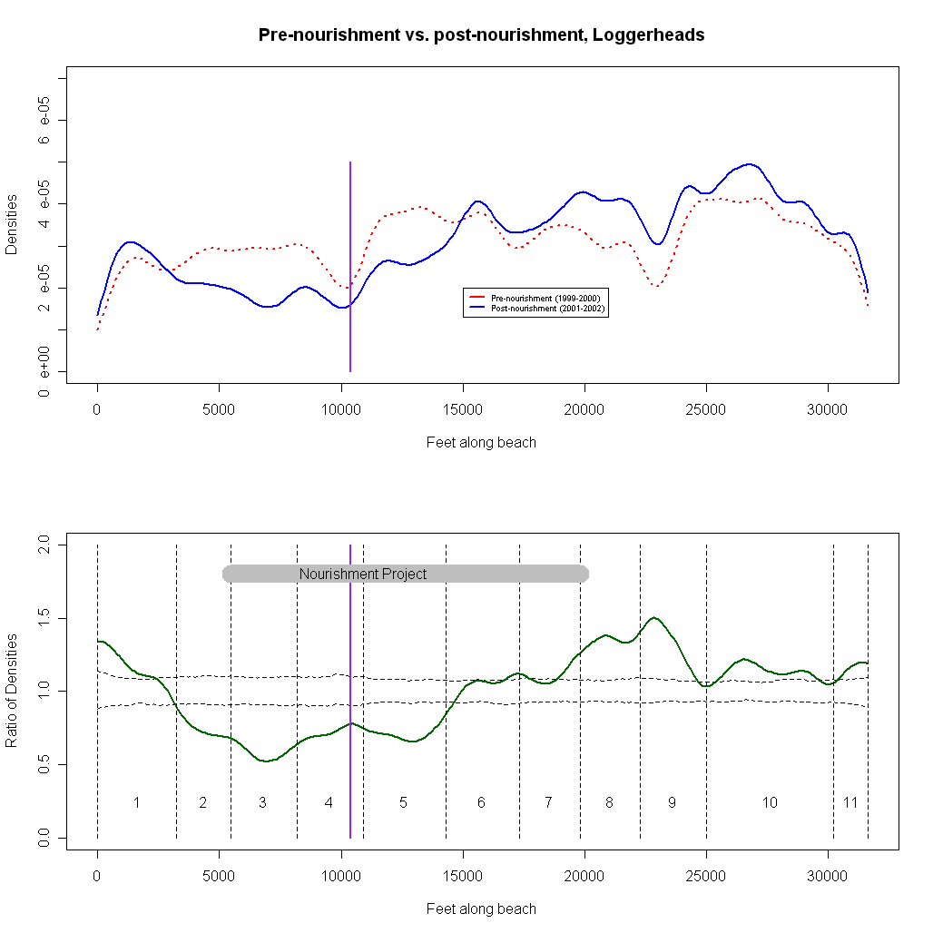
Loggerheads (all emergences)
Densities
Blue = post
Red = pre
More post-nour
No difference
Fewer post-nour
Ratio

Slide 15
What did we find?
Significant reduction of all emergences in northern portion of nourishment zone.
Significant increase of emergences immediately south of nourishment zone.
Impact on all emergences suggests offshore influence.

Slide 16
What’s my story?
Approach quantifies local impacts of nourishment project at the scale of the individual emergence.
Gradient of impact: approaching from the north, significant decreases begin north of nourished beach, significant increases begin near southern end of nourishment. Similar pattern observed for Jupiter Beach.
Suggests importance of available emergence sites “downstream” of nourishment projects

